Slide 1
Dynamixel SDK
ODROID Application

Slide 2
Contents
CONTENTS
Environment
H/W Setting
S/W Configuration
To do Demo
About Dynamixel SDK
Protocol
Packet
Use
Demo Examples
Lists
Demo & Codes
Structure (API Reference)
Folder
Class
Methods

Slide 3
Environment

Slide 4
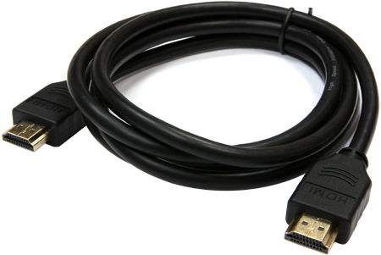
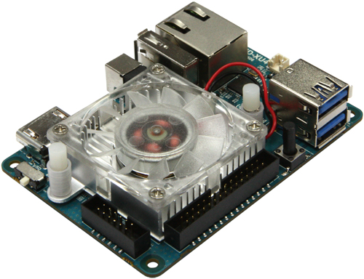
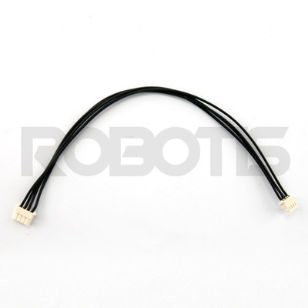

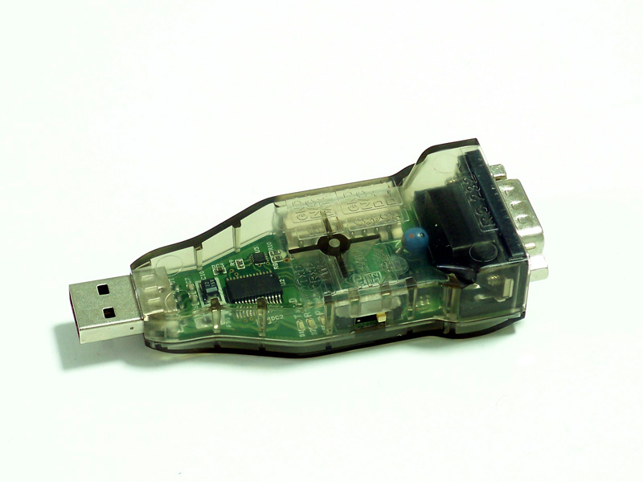
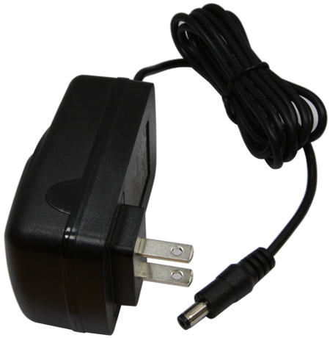

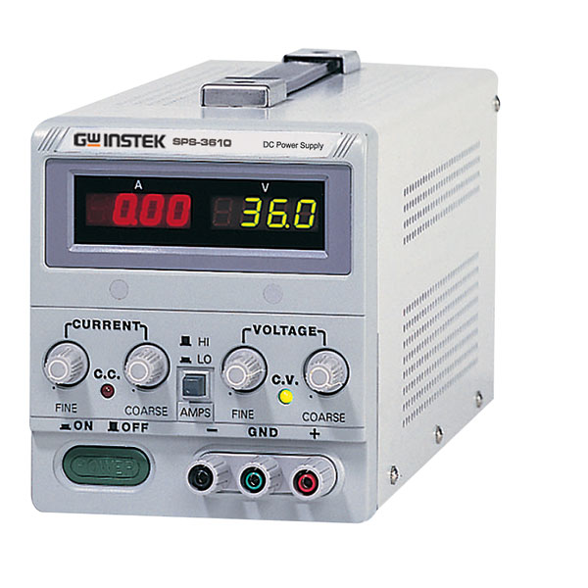
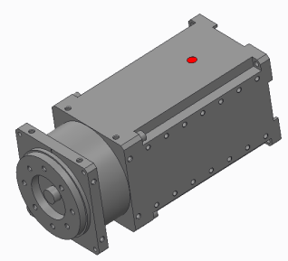
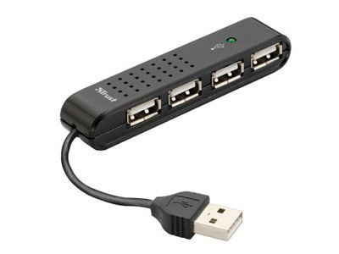
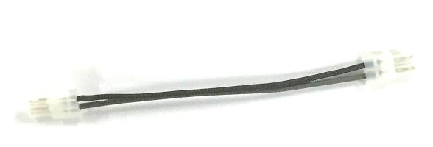
Environment
1. H/W Settings
HDMI A-A Type Cable
(Metal shielded)
x 4
x 2
ODROID XU4
4P Cables (Molex)
µSD Card
x 1
USB2Dynamixel
µSD-SD Adapter
24V Power Supply
5V/4A US Plug Power Supply
Dynamixel PRO
Power Cables
USB Hub

Slide 5
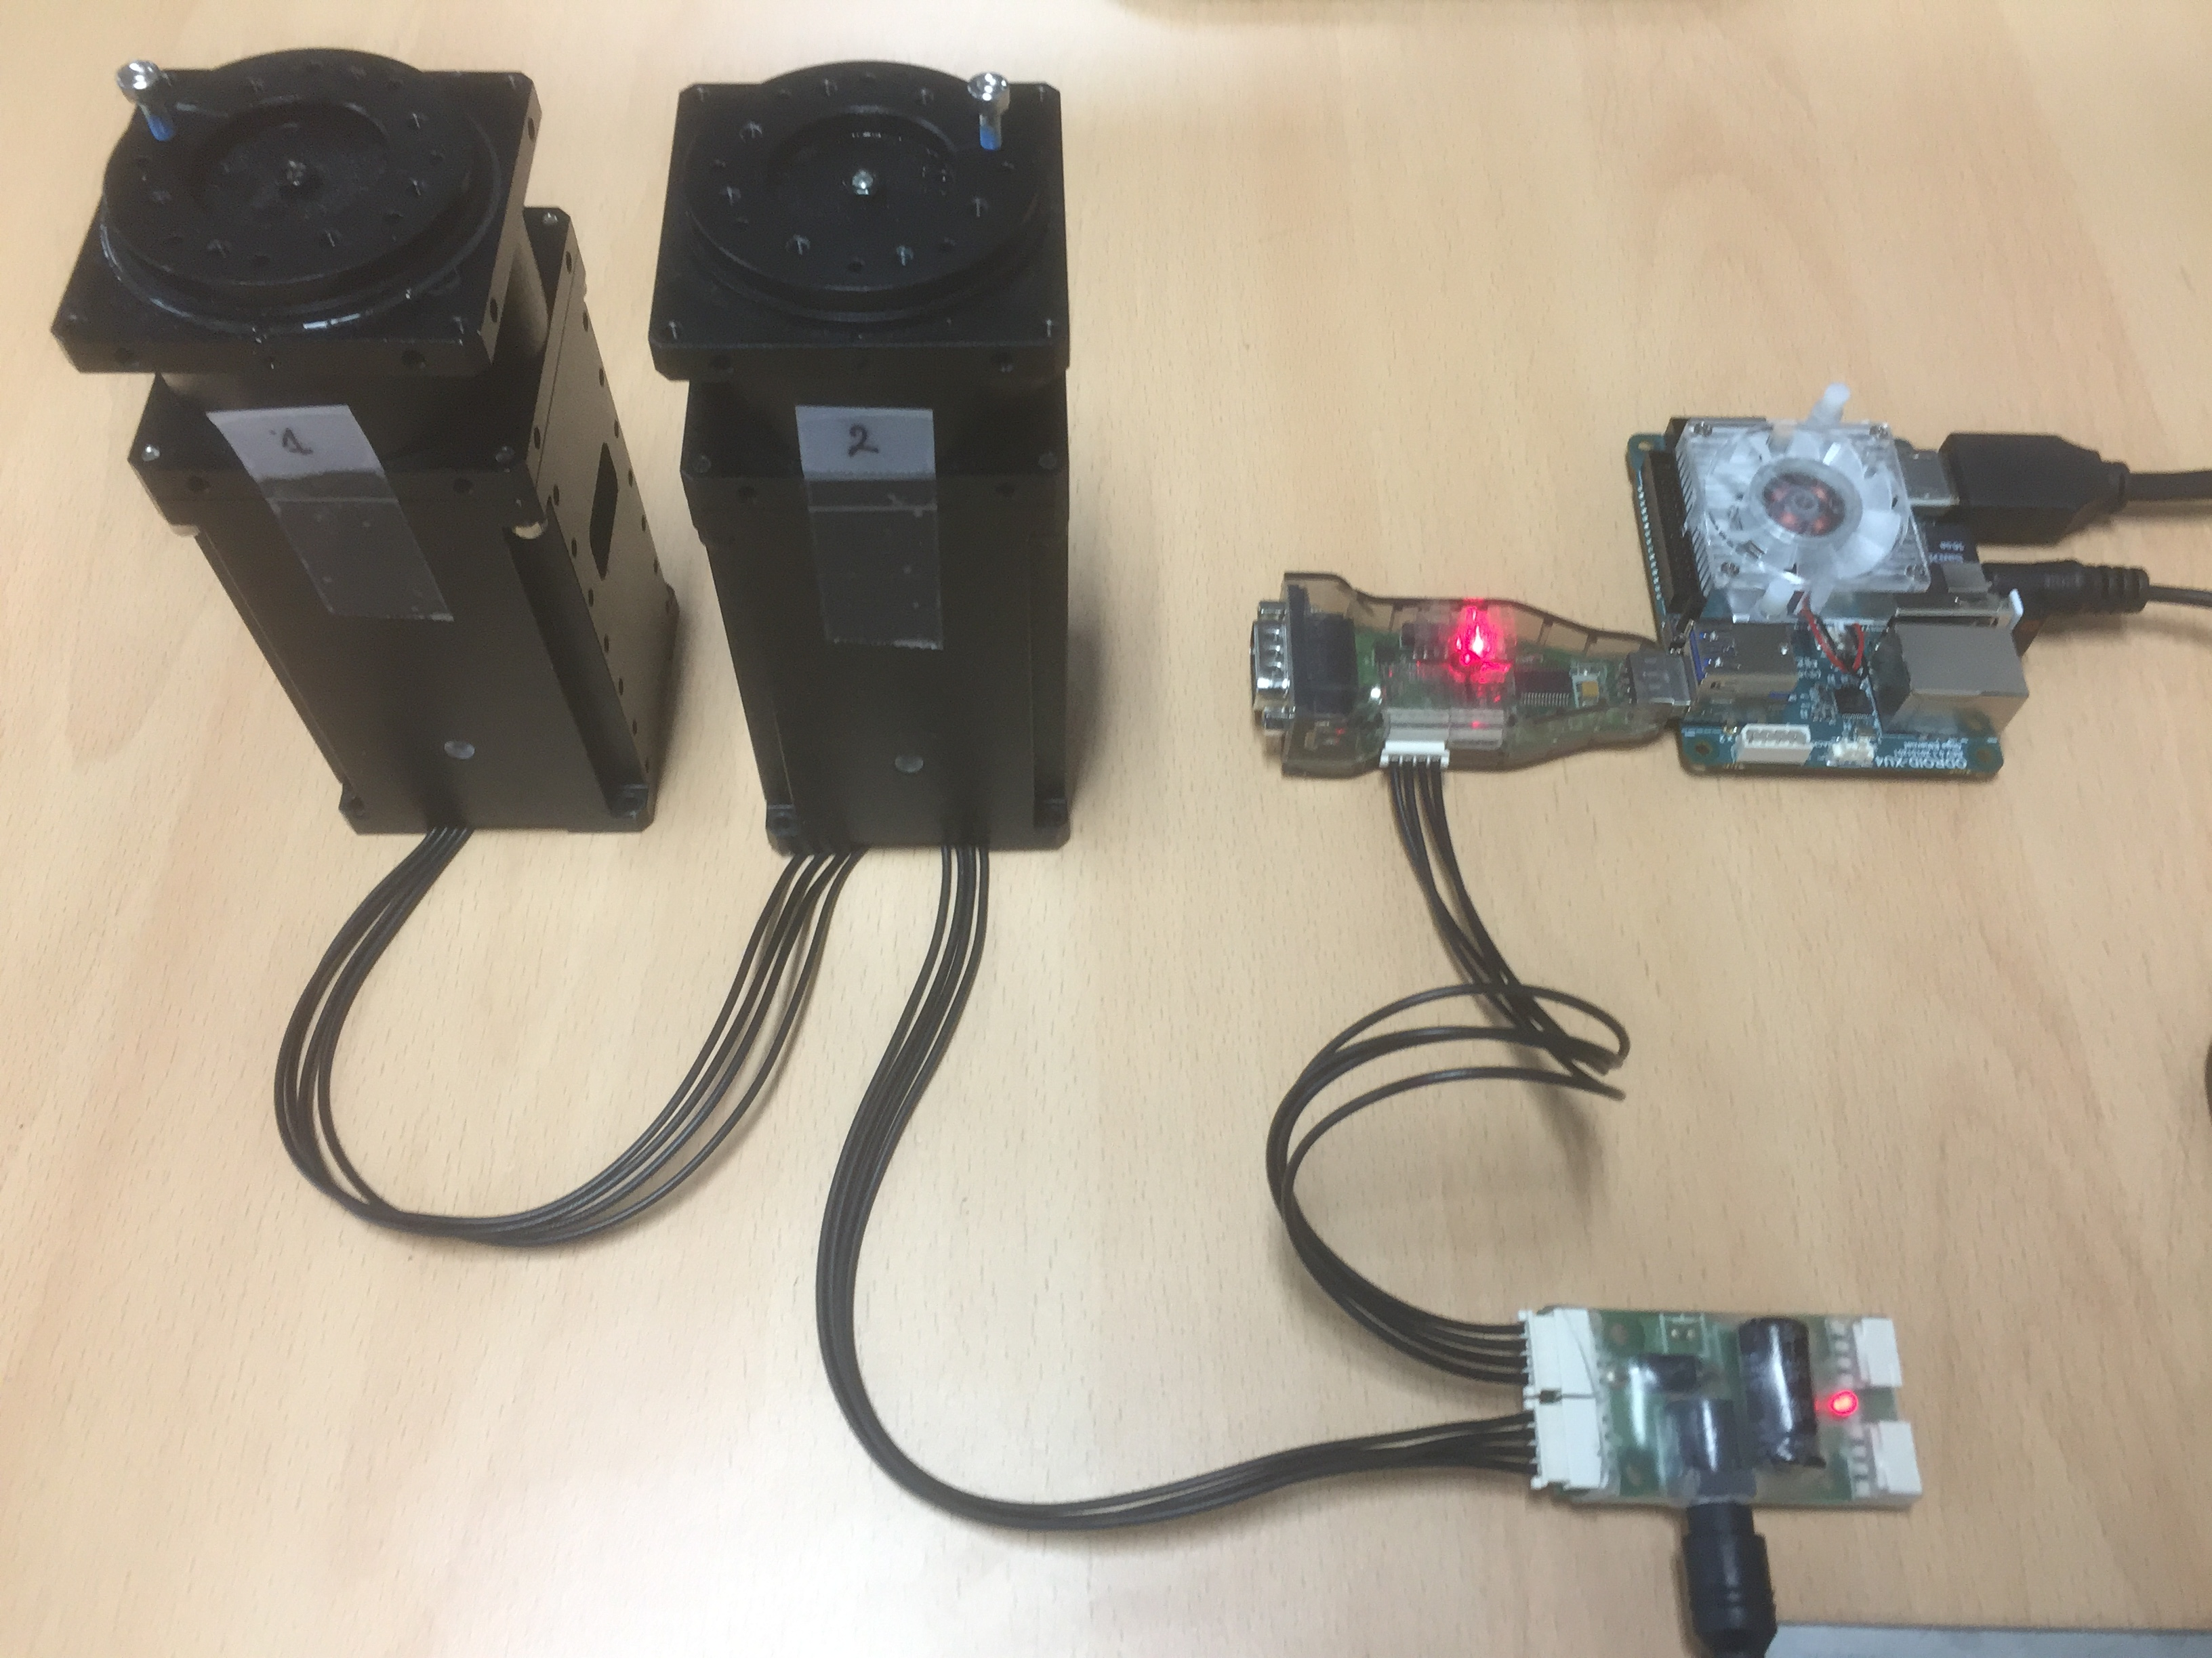
Environment
1. H/W Settings
- for examples
ODROID
HDMI
µSD Card
5V4A PWR
USB2Dynamixel
Dynamixels
ID 1 / ID 2
Baudrate : 1M
24 V PWR

Slide 6
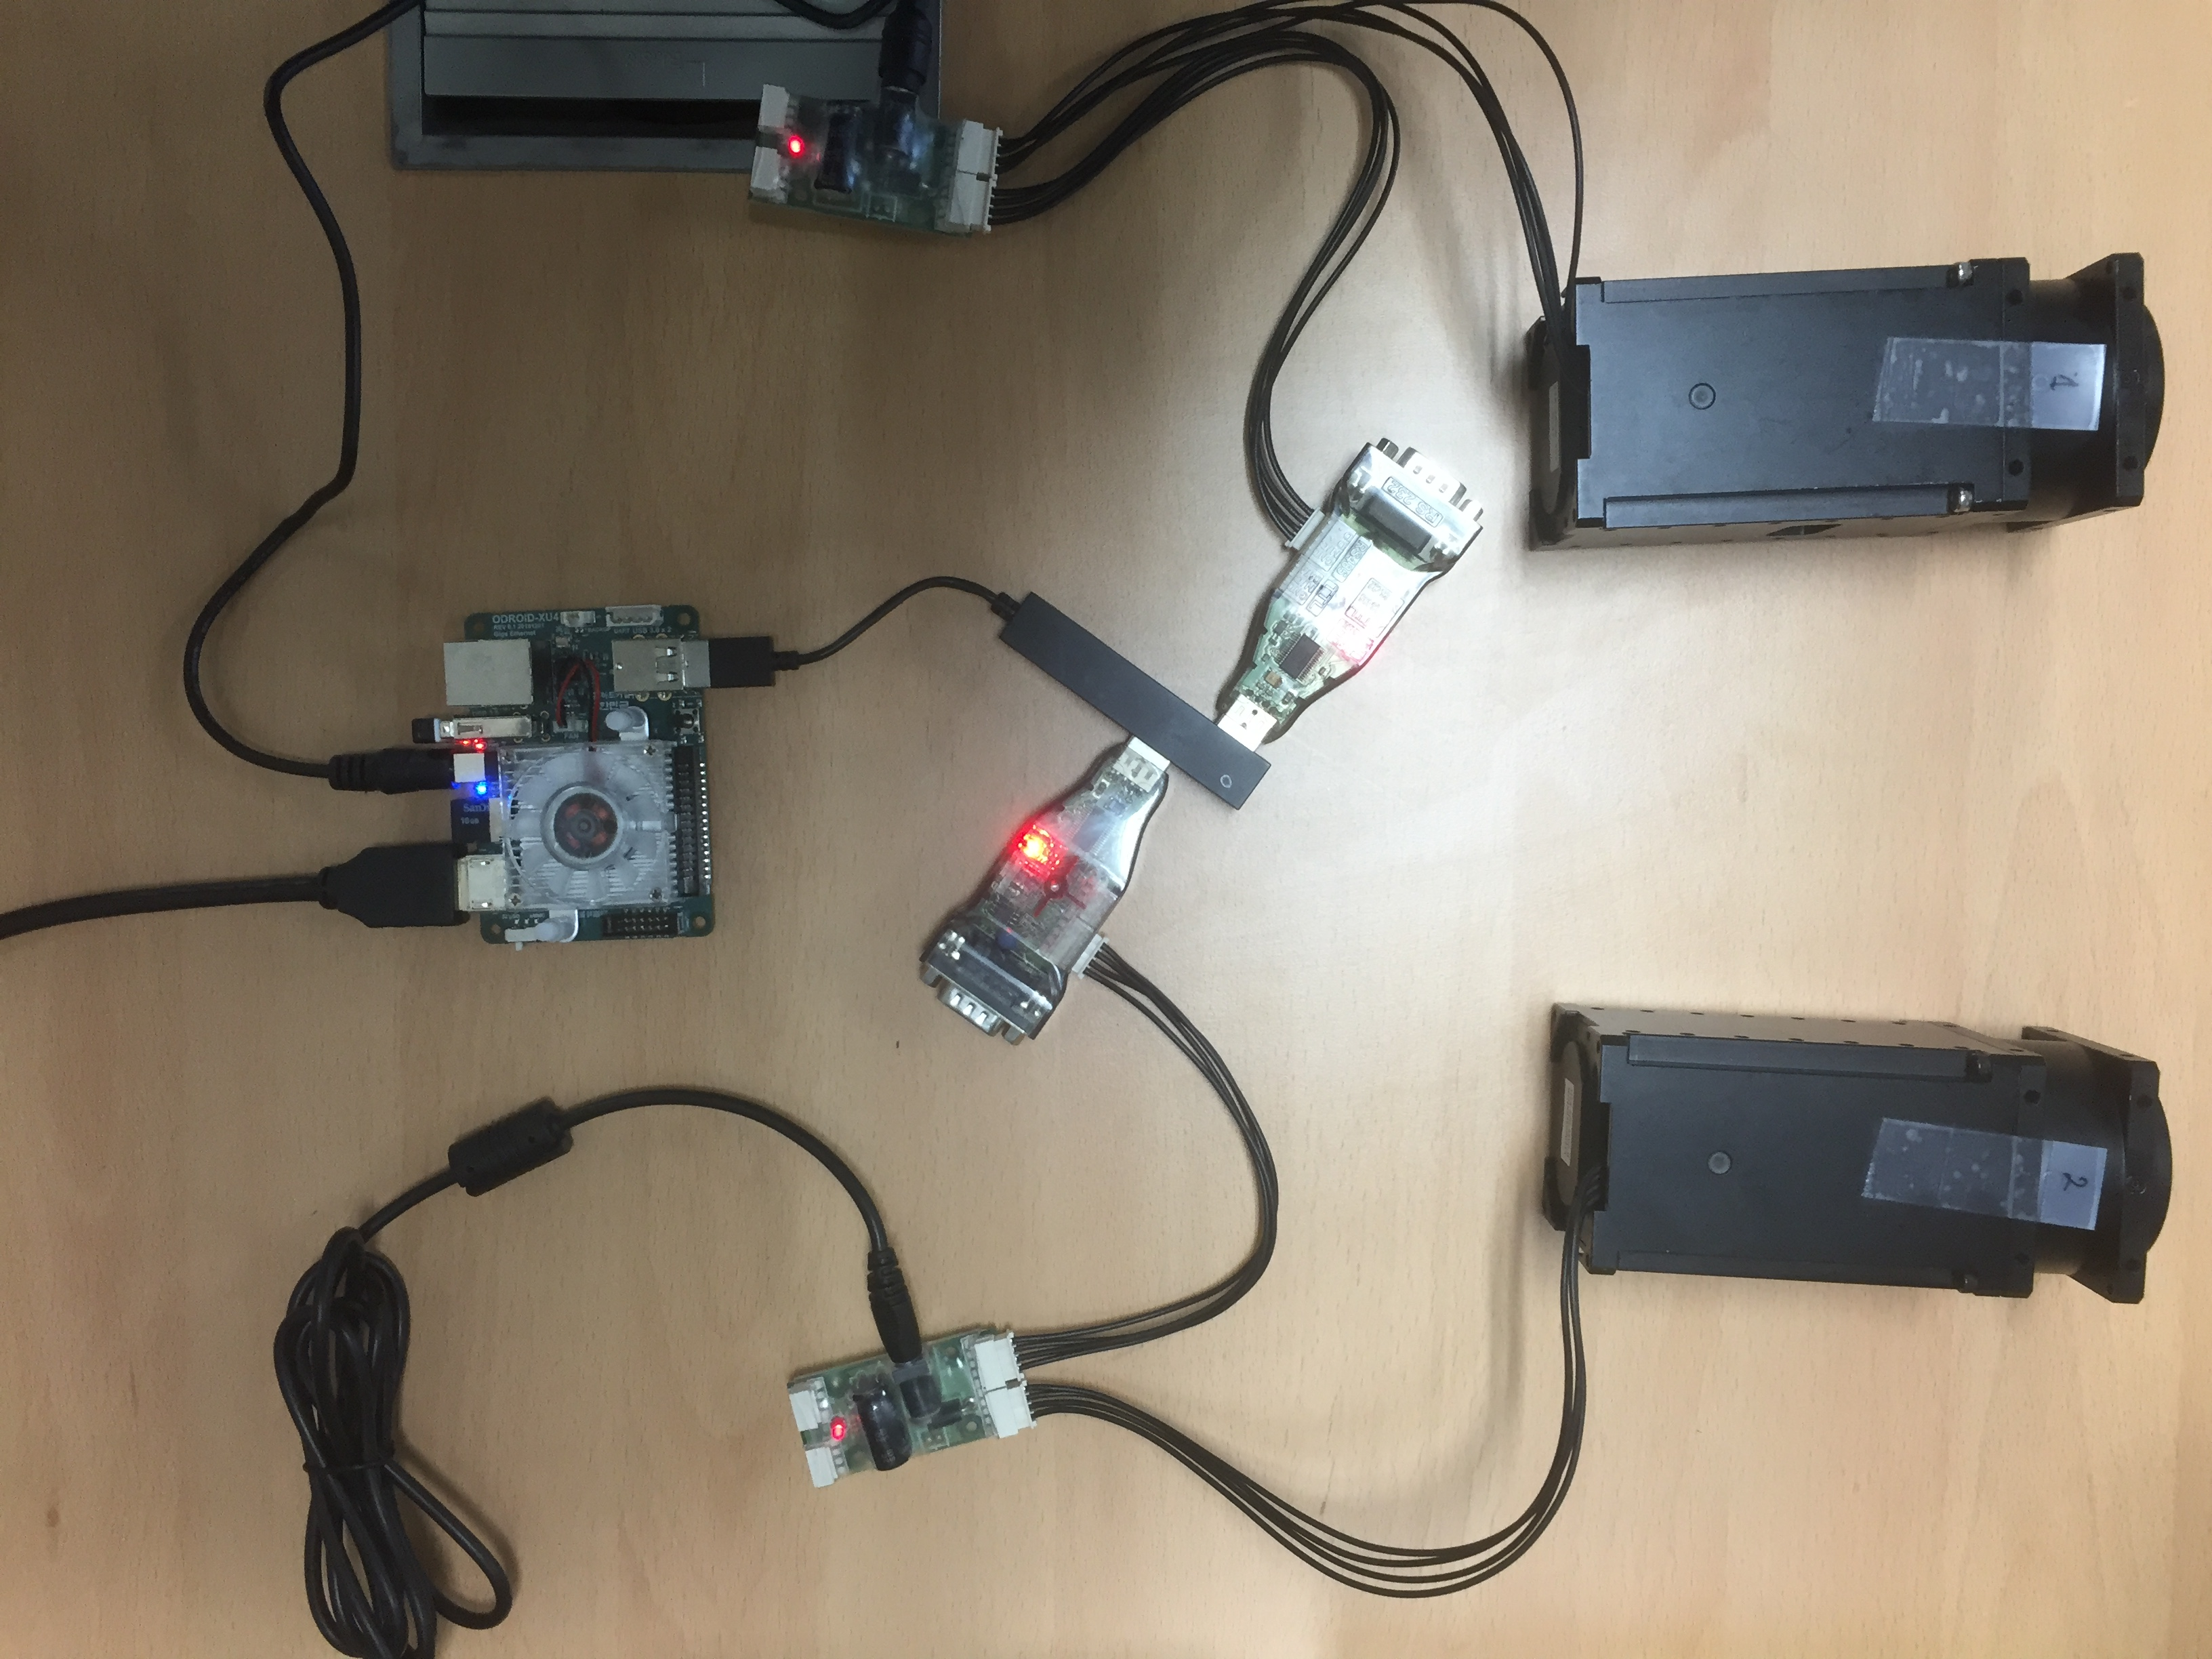
Environment
1. H/W Settings
- for MultiPort example on Linux
/dev/ttyUSB1
ID : 2
/dev/ttyUSB0
ID : 1

Slide 7
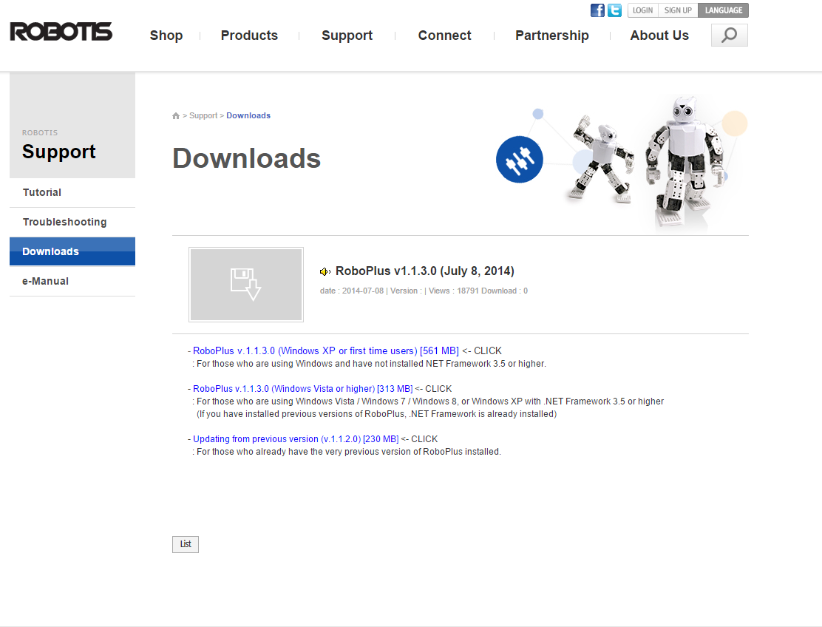
Environment
1. H/W Settings
- Dynamixel setting
Download “RoboPlus”:
en.robotis.com → Support → Download → RoboPlus v*.exe
Choose one

Slide 8
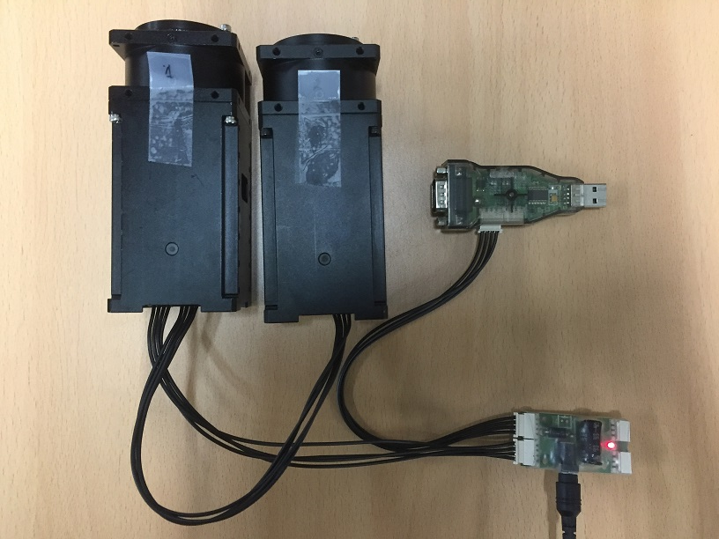
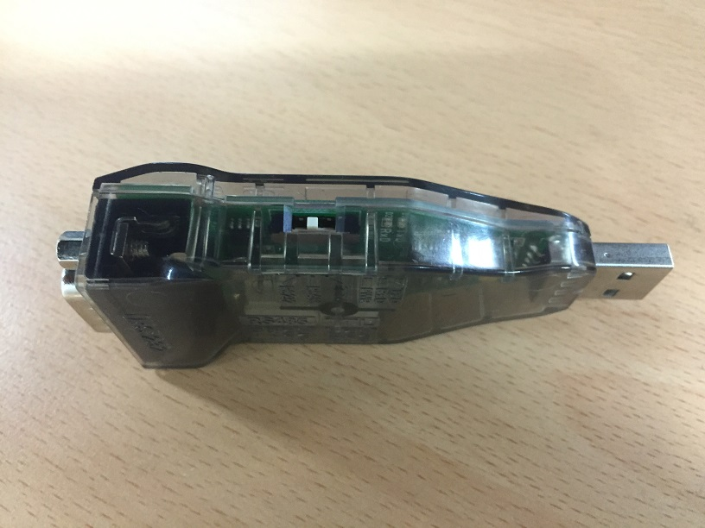
Environment
1. H/W Settings
- Dynamixel setting
Windows
Desktop
RS485

Slide 9
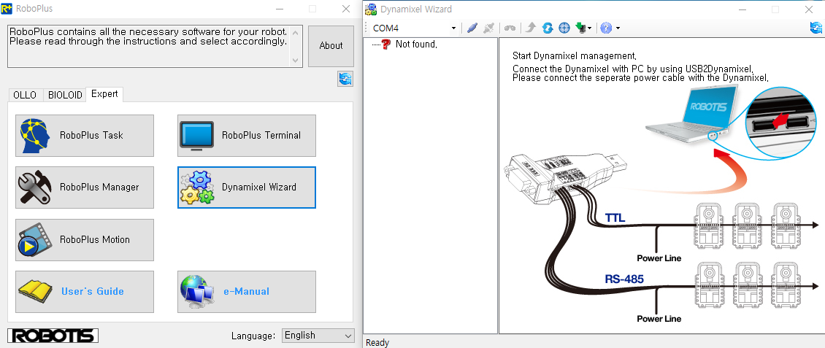
Environment
1. H/W Settings
- Dynamixel setting
1. Click Dynamiel Wizard
2. Select the port connected with USB2DXL (check this in device manager)
3. Connect
2
3
1

Slide 10
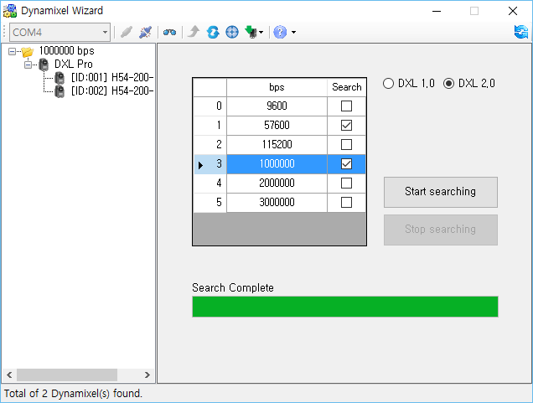
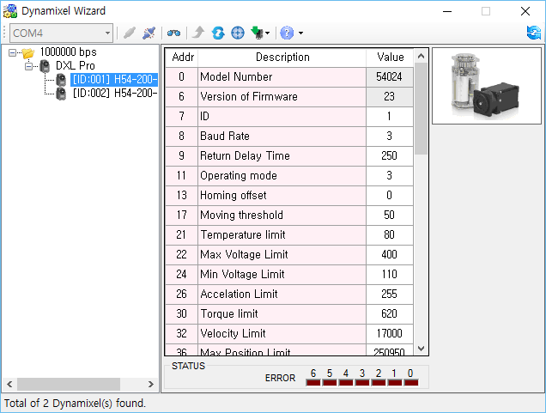
Environment
1. H/W Settings
- Dynamixel setting
1. Choose baudrate which you want to use to scan Dynamixels
2. Select DXL 2.0
3. Start searching
4. Choose Dynamixel that you want to edit its setting
5. Modify as: 1st DXL : ID = 1 / BaudRate = 3
2nd DXL : ID = 2 / BaudRate = 3
2
4
5
3
1

Slide 11
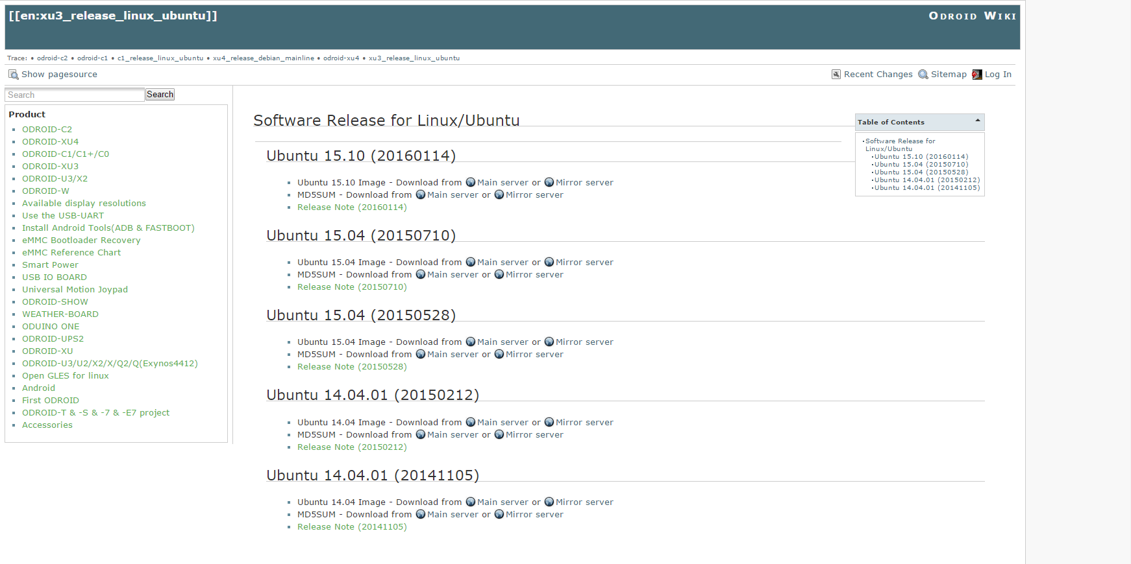
Environment
1. H/W Settings
- ODROID OS setting
1. Download ODROID OS image (*.img.xz file)
D/L | http://odroid.com/dokuwiki/doku.php?id=en:xu3_release_linux_ubuntu
1
Ubuntu 15.XX : ubuntu mate
Ubuntu 14.XX : Lubuntu
Unzip *.img.xz file with 7-zip
→ extract *.img file

Slide 12
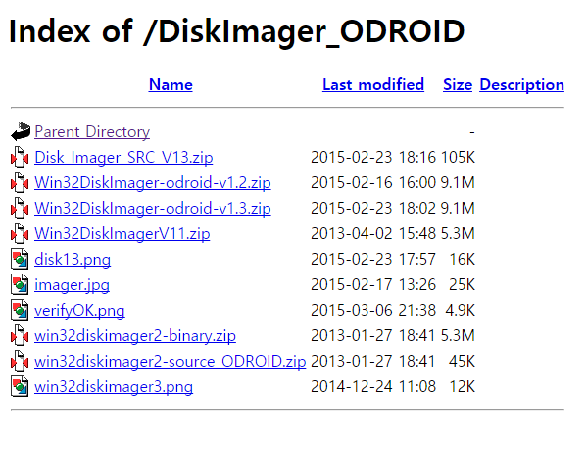
Environment
1. H/W Settings
- ODROID OS setting
1. Download Win32 Disk Imager for ODROID
D/L | http://dn.odroid.com/DiskImager_ODROID/
1
Exract and install it

Slide 13
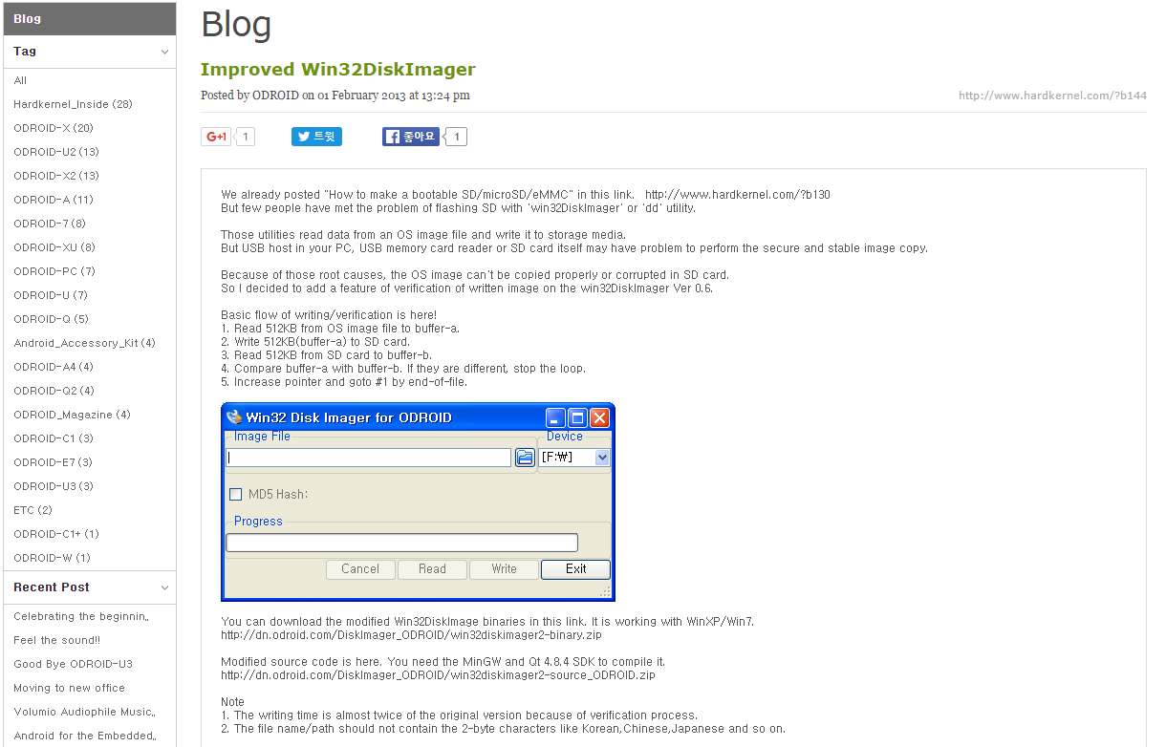
Environment
1. H/W Settings
- ODROID OS setting
Win XP, Win 7 users : See following at
http://com.odroid.com/sigong/blog/blog_list.php?bid=144

Slide 14
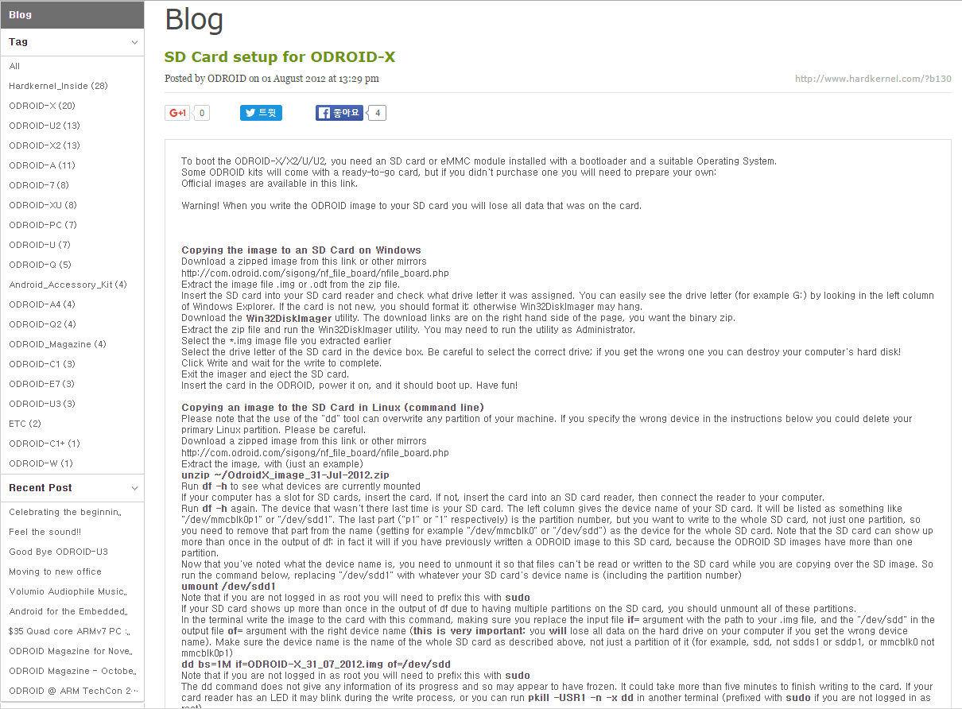
Environment
1. H/W Settings
- ODROID OS setting
Linux users : See following at
http://com.odroid.com/sigong/blog/blog_list.php?bid=130

Slide 15
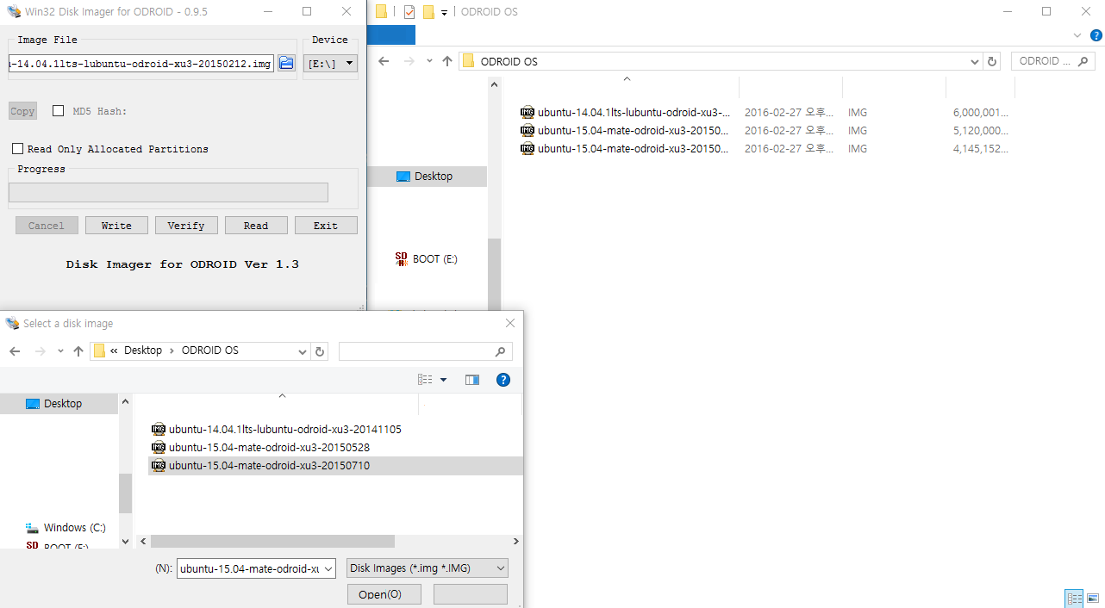
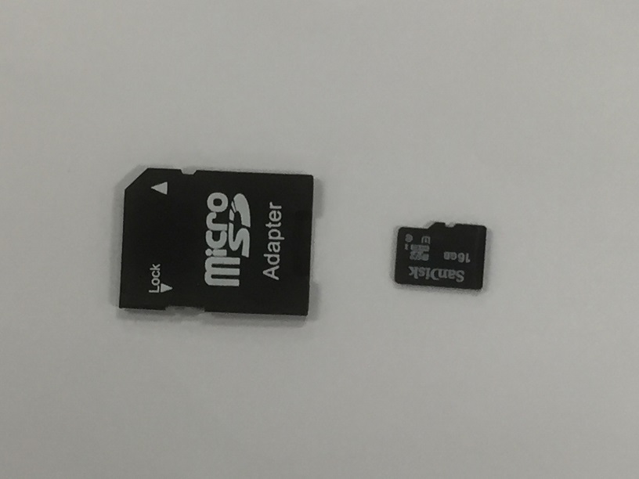
Environment
1. H/W Settings
- ODROID OS setting
4
2
1
5
1. Put into Desktop through SD Adapter
2. Choose *.img file to write on the μSD
3. Open *.img file
4. Select μSD Drive
3
5. Write

Slide 16
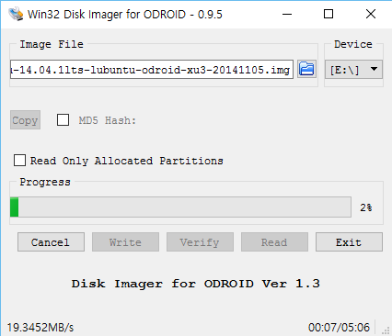
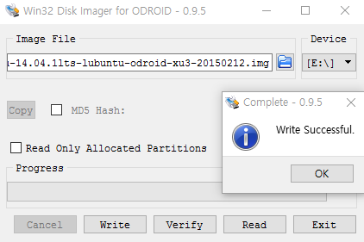
Environment
1. H/W Settings
- ODROID OS setting

Slide 17
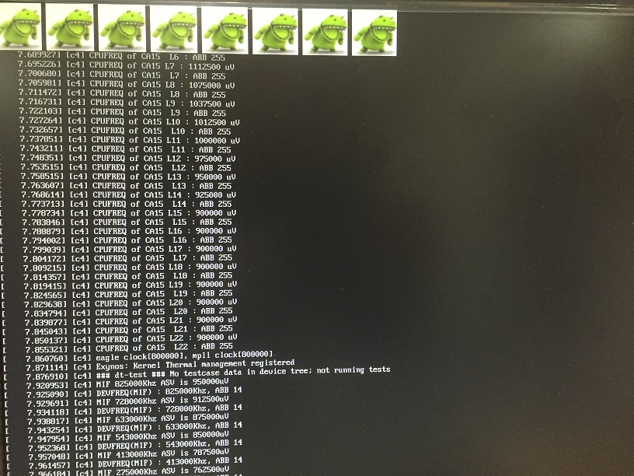
Environment
2. S/W Configuration
- Booting

Slide 18
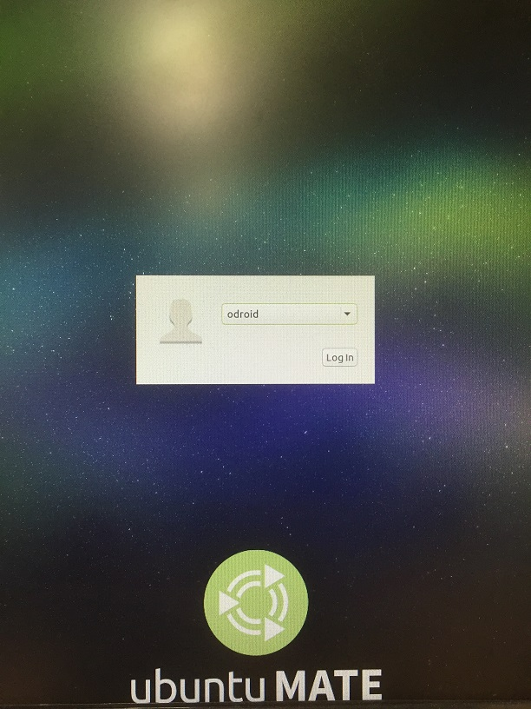
Environment
2. S/W Configuration
- Booting
Press “Log In” and keep going

Slide 19

Environment
2. S/W Configuration
- Booting

Slide 20
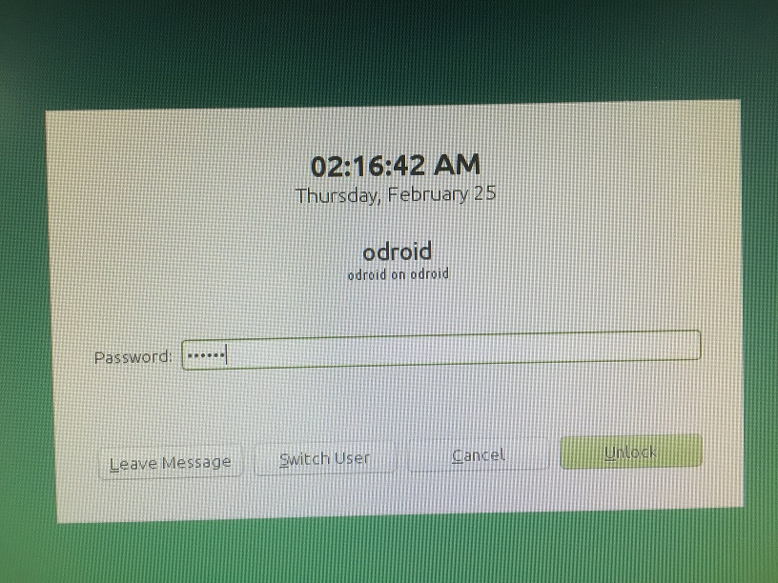
Environment
2. S/W Configuration
- Booting
If the system suspends, unlock it by typing Password : odroid

Slide 21
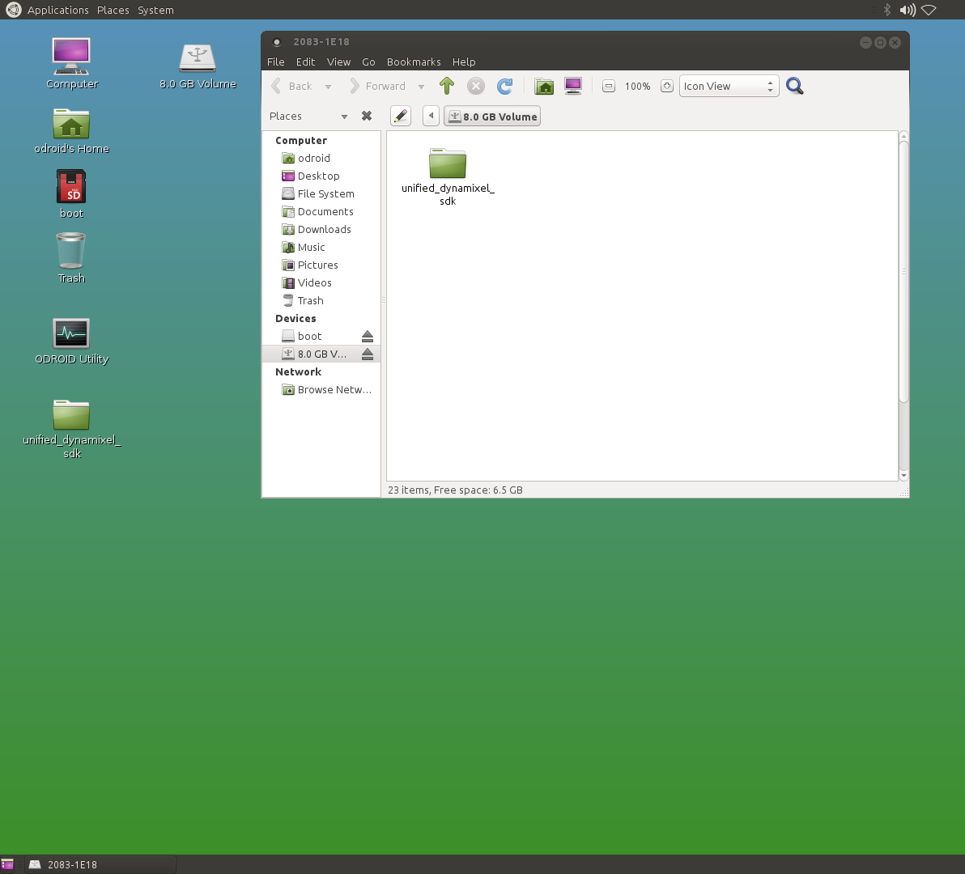
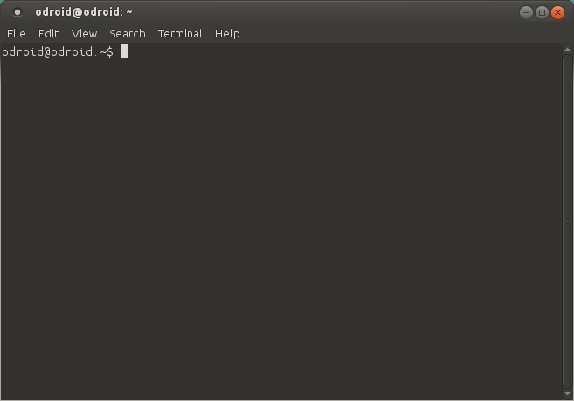
Environment
2. S/W Configuration
- Booting
2
1
1. Copy SDK file to Desktop
2. Application
→ System Tools
→ Mate Terminal
3. Play demos with Terminal
3

Slide 22
Environment
2. S/W Configuration
Source Download : DynamixelSDK_vX.Y.zip
https://github.com/ROBOTIS-GIT
Compiler
C : GNU gcc (Source is now being prepared…)
C++ : GNU g++
Build Tool
Build-essential → make

Slide 23
Environment
3. To do Demo
1. Type as shown below, and press enter
$ sudo su
$ [sudo] password for odroid: odroid
2. Compile the SDK source
$ cd Desktop/DynamixelSDK_vX.Y/c++/src
$ make install
(If the file already exists, type: $ make reinstall)
3. Compile the example source
$ cd ../example/Protocol1.0/[example_sourcefile_name]
$ make
(If the file already exists, type: $ make clean and then make)
4. Execute the example
$ ./[example_name]
then, something makes happen in Dynamixels!

Slide 24
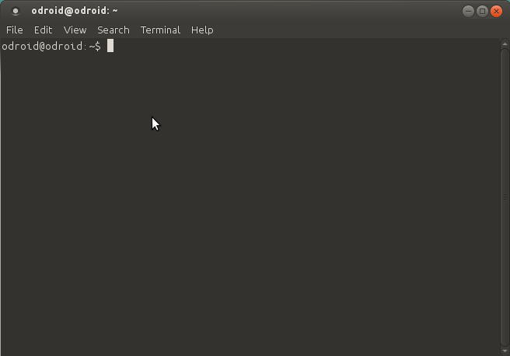
Environment
3. To do Demo
ex) ReadWrite
Open the Terminal

Slide 25
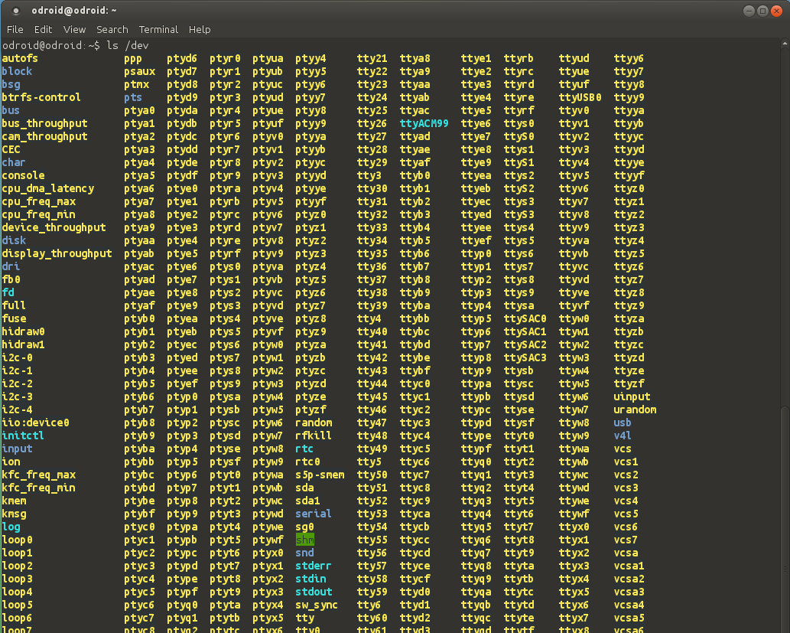
Environment
3. To do Demo
- See connected devices
ex) ReadWrite
1
1.
2
$ ls /dev
2. Check USB2Dynamixel
are recognized by the
controller as: ttyUSB0

Slide 26
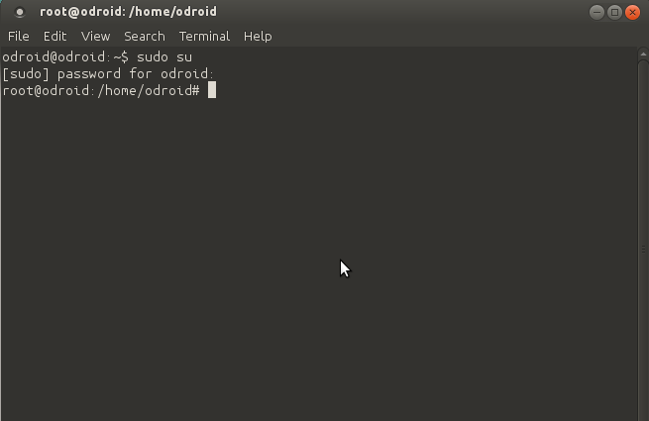
Environment
3. To do Demo
ex) ReadWrite
Type $ sudo su, then input P/W : [sudo] password for odroid: odroid

Slide 27
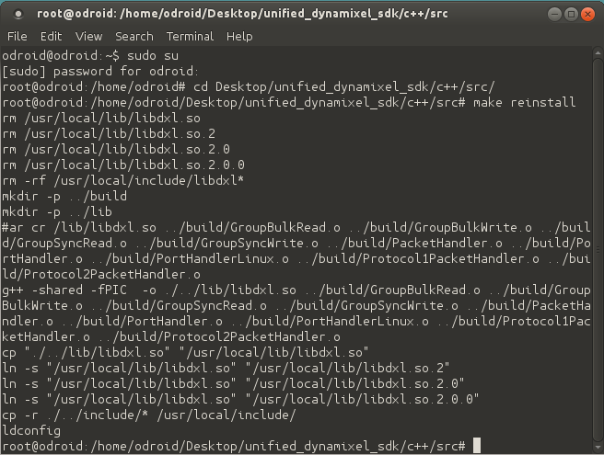
Environment
3. To do Demo
ex) ReadWrite
Type # cd/Desktop/DynamixelSDK_vX.Y/c++/src/ and press Enter
Type # make reinstall and press Enter

Slide 28
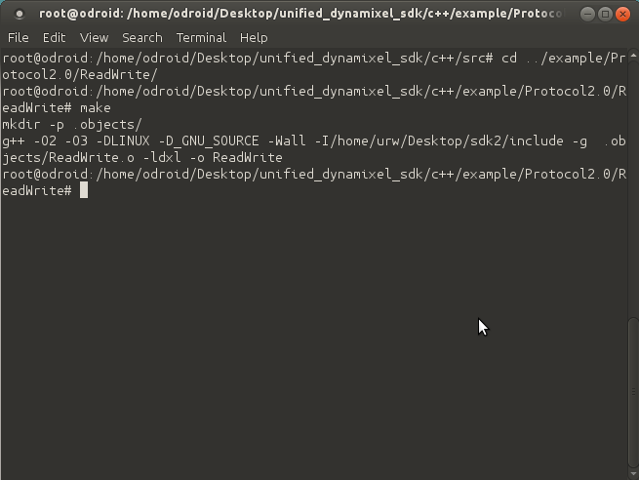
Environment
3. To do Demo
ex) ReadWrite
Type # cd ../example/Protocol2.0/ReadWrite/ and press Enter
Type # make and press Enter

Slide 29
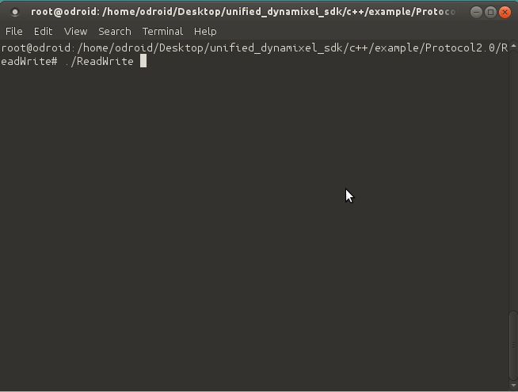
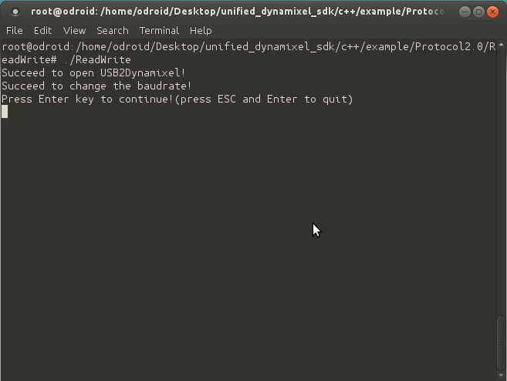
Environment
3. To do Demo
ex) ReadWrite
Type # ./ReadWrite and press Enter

Slide 30
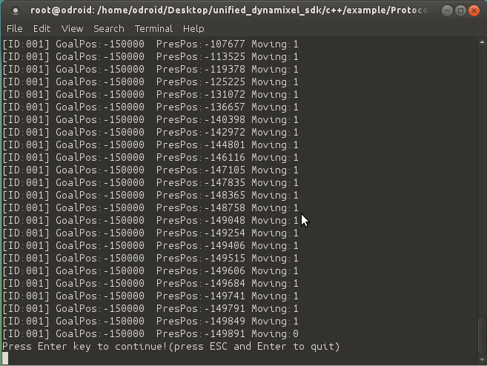
Environment
3. To do Demo
ex) ReadWrite
Press Enter again, and then the data appears to the terminal
Press Enter until you want to quit

Slide 31
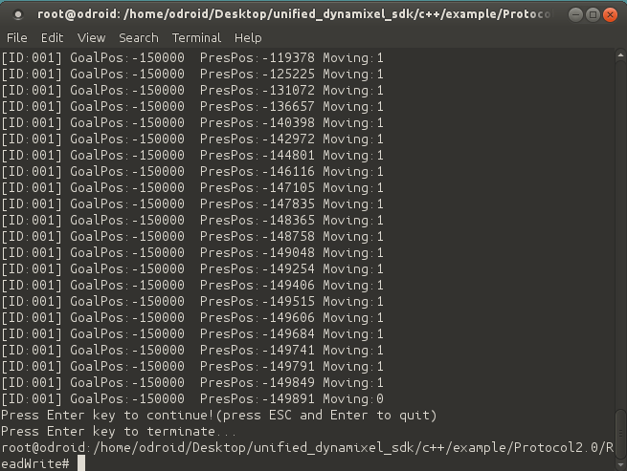
Environment
3. To do Demo
ex) ReadWrite
Press Esc and Enter to quit

Slide 32
About Dynamixel SDK

Slide 33

About Dynamixel SDK
Protocol
Dynamixel Protocol: a communication rule needed for Dynamixel control
“Rotate through 180 degrees!”
Instruction Packet
Status Packet
Controller
Dynamixel
“Done!”
“Failed!”
Protocol 1.0 : Dynamixel AX series / DX series / RX series / MX series
Protocol 2.0^{(*)} : Dynamixel PRO^{(**)}, XL
(*) Purpose: for better accuracy of signal transmission/reception
(**) Dynamixel PRO: Dynamixel series used in Manipulator and Thormang lineup

Slide 34
About Dynamixel SDK
2. Packet Architecture of Protocol 2.0
Instruction Packet
Header
Reserved (0x00)
ID
Packet
Length
Instruction
Parameters
CRC
WRITE:
“Change”
‘Goal position’ value
For checking
Packet error
# 1
~
# N
READ:
“Let me know”
’Present position’ &value
Target Dynamixel
…
…

Slide 35
About Dynamixel SDK
2. Packet Architecture of Protocol 2.0
Status Packet
Header
Reserved (0x00)
ID
Packet
Length
Instruction
(Status Packet)
Error
Parameters
CRC
‘Transmit Success’
or
‘Transmit Failed’
For checking
Packet error
# 1
~
# N
STATUS:
“Here is my reply”
Dynamixel
error
value = ’Present position’
Target Dynamixel
…

Slide 36
About Dynamixel SDK
3. Use
SDK API
Platform
PacketHandler
PortHandler
ID
Instruction
Parameter
Header
Length
ID
Instruction
Parameter
CRC
Transmit
Instr. Packet
Dynamixel
Instruction
Model number
Header
Length
Error
CRC
ID
Parameter
Receive
Status Packet
Present
position
ID & Parameter
No data

Slide 37
Example

Slide 38
Examples
1. Example List
Examples for Protocol 2.0 – Dynamixel PRO
Instructions
Examples
Ping
Read
Write
SyncRead
SyncWrite
BulkRead
BulkWrite
Reboot
FactoryReset
Ping
BroadcastPing
Examples | Contents
Ping | Get DXL model number
BroadcastPing | Scan connected DXL
ReadWrite | Position control
MultiPort | Use two ports
SyncReadWrite | Access multi DXLs
BulkReadWrite | Access multi DXL, ADDR
IndirectAddress | Use Indirect Address
Reboot | Reboot DXL
FactoryReset | Reset all DXL settings
ReadWrite
MultiPort
Sync ReadWrite
Indirect Address
Bulk ReadWrite
Reboot
FactoryReset

Slide 39
Examples
2. Demo & Codes
- Shared settings
PortHandler *portHandler = (PortHandler*)PortHandler::GetPortHandler(DEVICE_NAME);
: portHandler gets methods and members of PortHandlerLinux or PortHandlerWindows, and sets the DEVICE_NAME.
portHandler->OpenPort()
: portHandler opens and gets the handle of selected port.
portHandler->SetBaudRate(BAUDRATE)
: portHandler retries to open the selected port with selected BAUDRATE.
PacketHandler *packetHandler = PacketHandler::GetPacketHandler(PROTOCOL_VERSION);
: packetHandler gets methods and members of Protocol1PacketHandler or Protocol2PacketHandler by PROTOCOL_VERSION.
portHandler->ClosePort()
: portHandler closes selected port.

Slide 40
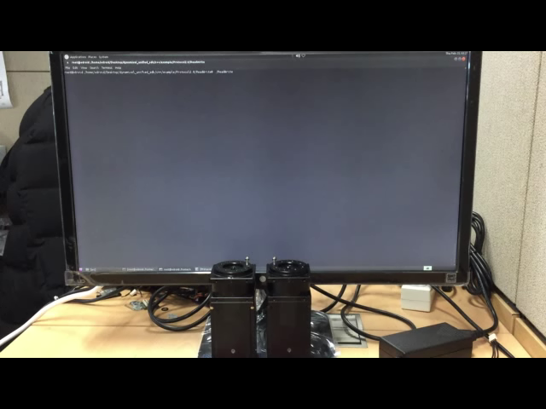
Examples
2. Demo & Codes
- ReadWrite : a Dynamixel rotates

Slide 41
Examples
2. Demo & Codes
- ReadWrite : a Dynamixel rotates
/* Headers */
#include ”dynamixel_sdk/DynamixelSDK.h”
// To handle the Dynamixel, include dynamixel_sdk/Dynamixel.h header file
/* defines */
#define DXL_ID 1
// ID Number of the Dynamixel
#define BAUDRATE 1000000
// The communication baudrate btw contoroller and Dynamixel
#define PROTOCOL_VERSION 2.0
// Protocol Version for making packet
#define DEVICE_NAME ”/dev/ttyUSB0”
// Device name for take a communication throught its port
#define ADDR_PRO_TORQUE_ENABLE 562
// Control table address of TORQUE ENABLE
#define ADDR_PRO_GOAL_POSITION 596
// Control table address of GOAL POSITION
#define ADDR_PRO_MOVING 610
// Control table address of MOVING status
#define ADDR_PRO_PRESENT_POSITION 611
// Control table address of PRESENT POSITION
continue to the next page...

Slide 42
Examples
2. Demo & Codes
- ReadWrite : a Dynamixel rotates
int main(){
/* Variables */
UINT8_T dxl_error = 0;
// Dynamixel error
int index = 0;
// Index for rotation direction
int dxl_goal_position[2] = {-150000, 150000};
// Dynamixel goal position value
UINT8_T dxl_torque_enable = 1;
// Dynamixel torque enable value
UINT8_T dxl_torque_disable = 0;
// Dynamixel torque disable value
UINT8_T dxl_moving = 0;
// Dynamixel moving status value
UINT16_T dxl_present_position = 0;
// Dynamixel present position value
/* Handlers */
PortHandler *portHandler = (PortHandler*)PortHandler::GetPortHandler(DEVICE_NAME);
PacketHandler *packetHandler = PacketHandler::GetPacketHandler(PROTOCOL_VERSION);
continue to the next page...

Slide 43
Examples
2. Demo & Codes
- ReadWrite : a Dynamixel rotates
portHandler->OpenPort()
portHandler->SetBaudRate(BAUDRATE)
/* Body */
packetHandler->Write1ByteTxRx(portHandler, DXL_ID, ADDR_TORQUE_ENABLE, dxl_torque_enable, &dxl_error);
While(1){ // While loop for Write goal position
if(_getch() == 0x1b) break; // Press ESC and ENTER to quit
packetHandler->Write4ByteTxRx(portHandler, DXL_ID, ADDR_GOAL_POSITION, dxl_goal_position[index], &dxl_error);
do{ // Do-While loop for Read present position
packetHandler->Read4ByteTxRx(portHandler, DXL_ID, ADDR_PRESENT_POSITION, &dxl_present_position, &dxl_error);
packetHandler->Read1ByteTxRx(portHandler, DXL_ID, ADDR_MOVING, &dxl_moving, &dxl_error);
printf(“[ID:%03d] Present Position = %05d”, DXL_ID, dxl_present_position);
}while(dxl_moving == 1)
if( index == 1 ) index = 1;
else index = 0;
}
packetHandler->Write1ByteTxRx(portHandler, DXL_ID, ADDR_TORQUE_ENABLE, dxl_torque_disable, &dxl_error);
portHandler->ClosePort()

Slide 44
Examples
2. Demo & Codes
- ReadWrite : a Dynamixel rotates
Explanation
[Replace below codes to the HEADERS]
#include ”dynamixel_sdk/DynamixelSDK.h”
: is needed to make packets and send it through the port.
[Replace below codes to the DEFINES]
#define DXL_ID 1
#define BAUDRATE 1000000
#define PROTOCOL_VERSION 2.0
#define DEVICE_NAME ”/dev/ttyUSB0”
: The example uses DXL_ID #1 at 1M baudrate. It makes Protocol 2.0 packet and sends through the port ”/dev/ttyUSB0”.
#define ADDR_PRO_TORQUE_ENABLE 562
#define ADDR_PRO_GOAL_POSITION 596
#define ADDR_PRO_MOVING 610
#define ADDR_PRO_PRESENT_POSITION 611
: defines addresses of the control table, which are used by Read and Write data.

Slide 45
Examples
2. Demo & Codes
- ReadWrite : a Dynamixel rotates
Explanation
[Replace below codes to the VARIABLES]
UINT8_T dxl_error = 0;
int index = 0;
int dxl_goal_position[2] = {-150000, 150000};
UINT8_T dxl_torque_enable = 1;
UINT8_T dxl_torque_disable = 0;
UINT8_T dxl_moving = 0;
UINT32_T dxl_present_position = 0;
: dxl_error keeps the error got from Dynamixel. The index indicates the rotation direction of Dynamixel. The dxl_goal_position points out where the Dynamixel should be rotated to. The value of dxl_torque_enable and dxl_torque_disable mean that torque ON and OFF, each. The dxl_moving shows the moving state of the Dynamixel. The dxl_present_position stores the present position value of Dynamixel.
[Replace below codes to the HANDLERS]
PortHandler *portHandler = (PortHandler*)PortHandler::GetPortHandler(DEVICE_NAME);
PacketHandler *packetHandler = PacketHandler::GetPacketHandler(PROTOCOL_VERSION);
: initialize the handlers of the port and the packet.

Slide 46
Examples
2. Demo & Codes
- ReadWrite : a Dynamixel rotates
Explanation
portHandler->OpenPort()
portHandler->SetBaudRate(BAUDRATE)
: opens the port and sets the port baudrate.
packetHandler->Write1ByteTxRx(portHandler, DXL_ID, ADDR_TORQUE_ENABLE, dxl_torque_enable, &dxl_error);
: enables the torque of the Dynamixel.
[Replace below codes to the BODY]
While(1){
if(_getch() == 0x1b) break;
packetHandler->Write4ByteTxRx(portHandler, DXL_ID, ADDR_GOAL_POSITION, dxl_goal_position[index], &dxl_error);
do{
packetHandler->Read4ByteTxRx(portHandler, DXL_ID, ADDR_PRESENT_POSITION, &dxl_present_position, &dxl_error);
packetHandler->Read1ByteTxRx(portHandler, DXL_ID, ADDR_MOVING, &dxl_moving, &dxl_error);
printf(“[ID:%03d] Present Position = %05d”, DXL_ID, dxl_present_position);
}while(dxl_moving == 1);
if( index == 1 ) index = 1;
else index = 0;
}
: starts to write either of the dxl_goal_positions and repeats Read the dxl_present_position and dxl_moving status until the Dynamixel stops moving. After that, the index indicates another dxl_goal_position by changing its value.

Slide 47
Examples
2. Demo & Codes
- ReadWrite : a Dynamixel rotates
Explanation
packetHandler->Write1ByteTxRx(portHandler, DXL_ID, ADDR_TORQUE_ENABLE, dxl_torque_disable, &dxl_error);
: disables the torque of the Dynamixel.
portHandler->ClosePort()
: closes the port.

Slide 48
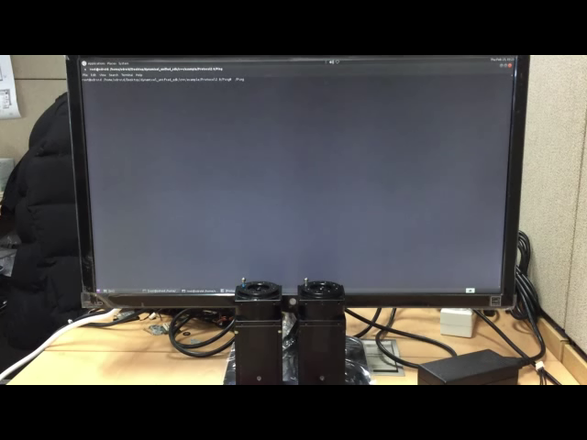
Examples
2. Demo & Codes
- Ping : shows model number of Dynamixel

Slide 49
Examples
2. Demo & Codes
- Ping : shows model number of Dynamixel
Explanation
[Replace below codes to the VARIABLES]
UINT8_T dxl_error = 0;
UINT16_T dxl_model_number = 0;
: dxl_error keeps the error got from Dynamixel. dxl_model_number stores the model number of Dynamixel.
[Replace below codes to the BODY]
packetHandler->Ping(portHandler, DXL_ID, &dxl_model_number, &dxl_error);
printf(”[ID:%03d] DXL model number : %d\n”, DXL_ID, dxl_model_number);
: tries to Ping the DXL_ID and gets dxl_model_number. Then, it shows the model number of the Dynamixel.

Slide 50

Examples
2. Demo & Codes
- BroadcastPing : shows the list of connected Dynamixels

Slide 51
Examples
2. Demo & Codes
- BroadcastPing : shows the list of connected Dynamixels
Explanation
[Replace below codes to the HEADERS]
#include <vector>
: Try to BroadcastPing all Dynamixels and gets the list of connected Dynamixels.
[Replace below codes to the VARIABLES]
UINT8_T dxl_error = 0;
std::vector<UINT8_T> vec;
: dxl_error keeps the error got from Dynamixel. ‘vec’ stores the list of connected Dynamixels
[Replace below codes to the BODY]
packetHandler->BroadcastPing(portHandler, vec);
for(int i = 0; i < (int)vec.size(); i++)
printf(”[ID:%03d]\n”, vec.at(i));
: tries to BroadcastPing all Dynamixels and gets the list of connected Dynamixels. Then, it shows the ID of connect Dynamixels

Slide 52
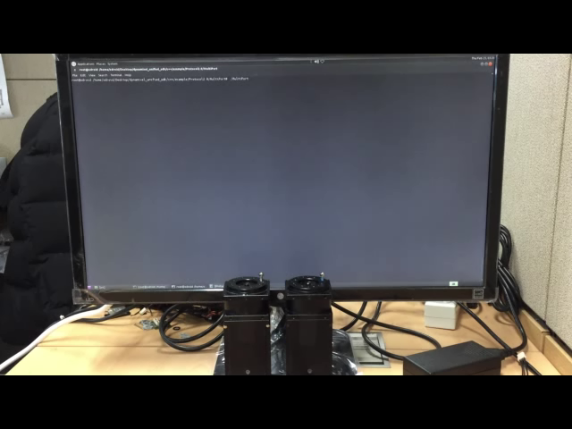
Examples
2. Demo & Codes
- MultiPort : two Dynamixels rotate using two ports

Slide 53
Examples
2. Demo & Codes
- MultiPort : two Dynamixels rotate using two ports
Explanation
packetHandler->Write4ByteTxRx(portHandler1, DXL1_ID, ADDR_GOAL_POSITION, dxl_goal_position, &dxl_error);
packetHandler->Write4ByteTxRx(portHandler2, DXL2_ID, ADDR_GOAL_POSITION, dxl_goal_position, &dxl_error);
: Write dxl_goal_positions to each Dynamixels through two ports.
packetHandler->Read4ByteTxRx(portHandler1, DXL1_ID, ADDR_PRESENT_POSITION, &dxl_present_position1, &dxl_error);
packetHandler->Read4ByteTxRx(portHandler2, DXL2_ID, ADDR_PRESENT_POSITION, &dxl_present_position2, &dxl_error);
: Read dxl_present_position on each Dynamixels through two ports.

Slide 54
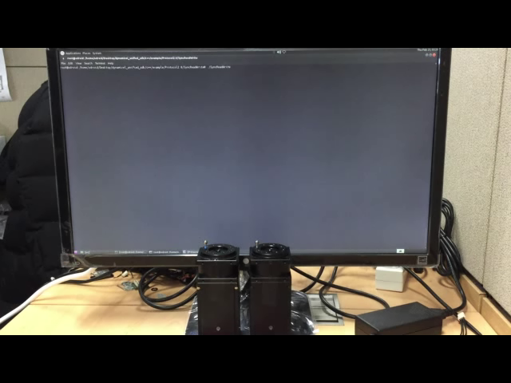
Examples
2. Demo & Codes
- SyncReadWrite : writes same data of two Dynamixels

Slide 55
Examples
2. Demo & Codes
- SyncReadWrite : writes same data of two Dynamixels
Explanation
[Replace below codes to the DEFINES]
#define ADDR_PRO_TORQUE_ENABLE 562
#define ADDR_PRO_GOAL_POSITION 596
#define ADDR_PRO_PRESENT_POSITION 611
: defines addresses of the control table, which are used by Sync Read and Write data.
#define LEN_PRO_TORQUE_ENABLE 1
#define LEN_PRO_GOAL_POSITION 4
#define LEN_PRO_PRESENT_POSITION 4
: defines byte length for each items.
#define DXL1_ID 1
#define DXL2_ID 2
#define BAUDRATE 1000000
#define PROTOCOL_VERSION 2.0
#define STOP_MOVING_MARGIN 20
: The example uses DXL_ID #1 and DXL_ID #2 at 1M baudrate. It makes Protocol 2.0 packet and sends through the port ”/dev/ttyUSB0”. STOP_MOVING_MARGIN is for deciding whether the Dynamixel moves or not

Slide 56
Examples
2. Demo & Codes
- SyncReadWrite : writes same data of two Dynamixels
[Replace below codes to the VARIABLES]
UINT8_T dxl_error = 0;
int index = 0;
int dxl_goal_position[2] = {-150000, 150000};
UINT8_T dxl_torque_enable = 1;
UINT8_T dxl_torque_disable = 0;
UINT8_T param_goal_position[4];
UINT32_T dxl_present_position1, dxl_present_position2 = 0;
: dxl_error keeps the error got from Dynamixel. The index indicates the rotation direction of Dynamixel. The dxl_goal_position points out where the Dynamixel should be rotated to. The value of dxl_torque_enable and dxl_torque_disable mean that torque ON and OFF, each. The dxl_goal_position will be allocated into param_goal_position byte array. The dxl_present_position1 and dxl_present_position2 store the present position value of Dynamixels.
[Replace below codes to the HANDLERS]
PortHandler *portHandler = (PortHandler*)PortHandler::GetPortHandler(DEVICE_NAME);
PacketHandler *packetHandler = PacketHandler::GetPacketHandler(PROTOCOL_VERSION);
GroupSyncWrite groupSyncWrite(portHandler, packetHandler, ADDR_GOAL_POSITION, LEN_GOAL_POSITION);
GroupSyncRead groupSyncRead(portHandler, packetHandler, ADDR_PRESENT_POSITION, LEN_PRESENT_POSITION);
: initialize the handlers of the port and the packet. Then initializes groupSyncWrite instance using two handlers above.

Slide 57
Examples
2. Demo & Codes
- SyncReadWrite : writes same data of two Dynamixels
[Replace below codes to the BODY]
packetHandler->Write1ByteTxRx(portHandler, DXL_ID, ADDR_TORQUE_ENABLE, dxl_torque_enable, &dxl_error);
: enables the torque of the Dynamixel.
groupSyncRead.AddParam(DXL1_ID);
groupSyncRead.AddParam(DXL2_ID);
: AddParameter storage for Dynamixel’s present position value
param_goal_position[0] = DXL_LOBYTE(DXL_LOWORD(dxl_goal_position));
param_goal_position[1] = DXL_HIBYTE(DXL_LOWORD(dxl_goal_position));
param_goal_position[2] = DXL_LOBYTE(DXL_HIWORD(dxl_goal_position));
While(1){
param_goal_position[3] = DXL_HIBYTE(DXL_HIWORD(dxl_goal_position));
if(_getch() == 0x1b) break;
: allocates dxl_goal_position into the byte array
packetHandler->Write4ByteTxRx(portHandler, DXL_ID, ADDR_GOAL_POSITION, dxl_goal_position[index], &dxl_error);
do{
groupSyncWrite.AddParam(DXL1_ID, param_goal_position);
packetHandler->Read4ByteTxRx(portHandler, DXL_ID, ADDR_PRESENT_POSITION, &dxl_present_position, &dxl_error);
groupSyncWrite.AddParam(DXL2_ID, param_goal_position);
packetHandler->Read1ByteTxRx(portHandler, DXL_ID, ADDR_MOVING, &dxl_moving, &dxl_error);
: AddParameter param_goal_position to groupSyncWrite parameter storage
printf(“[ID:%03d] Present Position = %05d”, DXL_ID, dxl_present_position);
}while(dxl_moving == 1);
groupSyncWrite.TxPacket();
if( index == 1 ) index = 1;
: Transmits the packet
else index = 0;
groupSyncWrite.ClearParam();
}
: ClearParameter of groupSyncWrite parameter storage.
: starts to write either of the dxl_goal_positions and repeats Read the dxl_present_position and dxl_moving status until the Dynamixel stops moving. After that, the index indicates another dxl_goal_position by changing its value.

Slide 58
Examples
2. Demo & Codes
- SyncReadWrite : writes same data of two Dynamixels
groupSyncRead.TxRxPacket();
: Transmits and receives the packet.
groupSyncRead.GetData(DXL1_ID, ADDR_PRESENT_POSITION, &dxl_present_position);
groupSyncRead.GetData(DXL2_ID, ADDR_PRESENT_POSITION, &dxl_present_position);
: GetData of dxl_present_positions
groupSyncRead.ClearParam();
: ClearParameter of groupSyncRead parameter storage.
packetHandler->Write1ByteTxRx(portHandler, DXL_ID, ADDR_TORQUE_ENABLE, dxl_torque_disable, &dxl_error);
: disables the torque of the Dynamixel.

Slide 59

Examples
2. Demo & Codes
- BulkReadWrite : writes different data of two Dynamixels

Slide 60
Examples
2. Demo & Codes
- BulkReadWrite : writes different data of two Dynamixels
Explanation
[Replace below codes to the DEFINES]
#define ADDR_PRO_TORQUE_ENABLE 562
#define ADDR_PRO_LED_RED 563
#define ADDR_PRO_GOAL_POSITION 596
#define ADDR_PRO_PRESENT_POSITION 611
: defines addresses of the control table, which are used by Bulk Read and Write data.
#define LEN_PRO_TORQUE_ENABLE 1
#define LEN_PRO_LED_RED 1
#define LEN_PRO_GOAL_POSITION 4
#define LEN_PRO_PRESENT_POSITION 4
: defines byte length for each items.
#define DXL1_ID 1
#define DXL2_ID 2
#define BAUDRATE 1000000
#define PROTOCOL_VERSION 2.0
#define STOP_MOVING_MARGIN 20
: The example uses DXL_ID #1 and DXL_ID #2 at 1M baudrate. It makes Protocol 2.0 packet and sends through the port ”/dev/ttyUSB0”. STOP_MOVING_MARGIN is for deciding whether the Dynamixel moves or not

Slide 61
Examples
2. Demo & Codes
- BulkReadWrite : writes different data of two Dynamixels
[Replace below codes to the VARIABLES]
UINT8_T dxl_error = 0;
int index = 0;
int dxl_goal_position[2] = {-150000, 150000};
UINT8_T dxl_led_value[2] = {0x00, 0xFF};
UINT8_T dxl_torque_enable = 1;
UINT8_T dxl_torque_disable = 0;
UINT8_T param_goal_position[4];
UINT8_T dxl_led_value_read2;
UINT32_T dxl_present_position1 = 0;
: dxl_error keeps the error got from Dynamixel. The index indicates the rotation direction of Dynamixel. The dxl_goal_position points out where the Dynamixel should be rotated to. dxl_goal_position shows the value of LED. The value of dxl_torque_ enable and dxl_torque_disable mean that torque ON and OFF, each. The dxl_goal_position will be allocated into param_goal_position byte array. The dxl_present_position1 and dxl_led_value_read2 store either of the present position and LED value of Dynamixels.
[Replace below codes to the HANDLERS]
PortHandler *portHandler = (PortHandler*)PortHandler::GetPortHandler(DEVICE_NAME);
PacketHandler *packetHandler = PacketHandler::GetPacketHandler(PROTOCOL_VERSION);
GroupBulkWrite groupBulkWrite(portHandler, packetHandler);
GroupBulkRead groupBulkRead(portHandler, packetHandler);
: initialize the handlers of the port and the packet. Then initializes groupBulkWrite instance using two handlers above.

Slide 62
Examples
2. Demo & Codes
- BulkReadWrite : writes different data of two Dynamixels
[Replace below codes to the BODY]
packetHandler->Write1ByteTxRx(portHandler, DXL_ID, ADDR_TORQUE_ENABLE, dxl_torque_enable, &dxl_error);
: enables the torque of the Dynamixel.
groupBulkRead.AddParam(DXL1_ID, ADDR_PRESENT_POSITION, LEN_PRESENT_POSITION);
groupBulkRead.AddParam(DXL2_ID, ADDR_LED_RED, LEN_LED_RED);
: AddParameter storage for Dynamixel’s present position and LED value
param_goal_position[0] = DXL_LOBYTE(DXL_LOWORD(dxl_goal_position));
param_goal_position[1] = DXL_HIBYTE(DXL_LOWORD(dxl_goal_position));
param_goal_position[2] = DXL_LOBYTE(DXL_HIWORD(dxl_goal_position));
param_goal_position[3] = DXL_HIBYTE(DXL_HIWORD(dxl_goal_position));
: allocates dxl_goal_position into the byte array
groupBulkWrite.AddParam(DXL1_ID , ADDR_GOAL_POSITION, LEN_GOAL_POSITION, param_goal_position);
groupBulkWrite.AddParam(DXL2_ID , ADDR_LED_RED, LEN_LED_RED, led_value);
: AddParameter param_goal_position and led_value to groupBulkWrite parameter storage
groupBulkWrite.TxPacket();
: Transmits the packet
groupBulkWrite.ClearParam();
: ClearParameter of groupBulkWrite parameter storage.

Slide 63
Examples
2. Demo & Codes
- BulkReadWrite : writes different data of two Dynamixels
groupBulkRead.TxRxPacket();
: Transmits and receives the packet.
groupBulkRead.GetData(DXL1_ID, ADDR_PRESENT_POSITION, &dxl_present_position);
groupBulkRead.GetData(DXL2_ID, ADDR_LED_RED, &dxl_led_value_read);
: GetData dxl_present_position or dxl_led_value_read from either of the Dynamixels
groupBulkRead.ClearParam();
: ClearParameter of groupBulkRead parameter storage.
packetHandler->Write1ByteTxRx(portHandler, DXL_ID, ADDR_TORQUE_ENABLE, dxl_torque_disable, &dxl_error);
: disables the torque of the Dynamixel.

Slide 64

Examples
2. Demo & Codes
- IndirectAddress : writes datas indirectly

Slide 65
Examples
2. Demo & Codes
- IndirectAddress : writes datas indirectly
packetHandler->Write2ByteTxRx(portHandler, DXL_ID, ADDR_INDIRECTADDR_WRITE + 0, ADDR_GOAL_POS + 0, &dxl_error);
packetHandler->Write2ByteTxRx(portHandler, DXL_ID, ADDR_INDIRECTADDR_WRITE + 2, ADDR_GOAL_POS + 1, &dxl_error);
packetHandler->Write2ByteTxRx(portHandler, DXL_ID, ADDR_INDIRECTADDR_WRITE + 4, ADDR_GOAL_POS + 2, &dxl_error);
packetHandler->Write2ByteTxRx(portHandler, DXL_ID, ADDR_INDIRECTADDR_WRITE + 6, ADDR_GOAL_POS + 3, &dxl_error);
packetHandler->Write2ByteTxRx(portHandler, DXL_ID, ADDR_INDIRECTADDR_WRITE + 8, ADDR_LED_RED, &dxl_error);
: makes INDIRECTDATA replace 4 Byte GOAL_POSITION and 1 Byte LED_RED.
GroupSyncWrite groupSyncWrite(portHandler, packetHandler, ADDR_INDIRECTDATA_WRITE, LEN_INDIRECTDATA_WRITE);
: initializes groupSyncWrite instance and points out the INDIRECTADDRESS.
param_indirect_data_write[0] = DXL_LOBYTE(DXL_LOWORD(dxl_goal_position));
param_indirect_data_write[1] = DXL_HIBYTE(DXL_LOWORD(dxl_goal_position));
param_indirect_data_write[2] = DXL_LOBYTE(DXL_HIWORD(dxl_goal_position));
param_indirect_data_write[3] = DXL_HIBYTE(DXL_HIWORD(dxl_goal_position));
param_indirect_data_write[4] = dxl_led_value;
: allocates dxl_goal_position and dxl_led_value into the byte array
groupSyncWrite.AddParam(DXL_ID, param_indirect_data_write);
: AddParameter storage for the datas

Slide 66
Examples
2. Demo & Codes
- IndirectAddress : writes datas indirectly
packetHandler->Write2ByteTxRx(portHandler, DXL_ID, ADDR_INDIRECTADDR_READ + 0, ADDR_PRES_POS + 0, &dxl_error);
packetHandler->Write2ByteTxRx(portHandler, DXL_ID, ADDR_INDIRECTADDR_READ + 2, ADDR_PRES_POS + 1, &dxl_error);
packetHandler->Write2ByteTxRx(portHandler, DXL_ID, ADDR_INDIRECTADDR_READ + 4, ADDR_PRES_POS + 2, &dxl_error);
packetHandler->Write2ByteTxRx(portHandler, DXL_ID, ADDR_INDIRECTADDR_READ + 6, ADDR_PRES_POS + 3, &dxl_error);
packetHandler->Write2ByteTxRx(portHandler, DXL_ID, ADDR_INDIRECTADDR_READ + 8, ADDR_MOVING, &dxl_error);
: makes INDIRECTDATA replace 4 Byte PRESENT_POSITION and 1 Byte MOVING.
GroupSyncRead groupSyncRead(portHandler, packetHandler, ADDR_INDIRECTADDR_READ, LEN_INDIRECTDATA_READ);
: initializes groupSyncRead instance and points out the INDIRECTADDRESS.
groupSyncRead.AddParam(DXL_ID);
: AddParameter storage for Dynamixel’s present position and LED value
groupSyncRead.GetData(DXL_ID, ADDR_INDIRECTDATA_READ, &dxl_present_position);
groupSyncRead.GetData(DXL_ID, ADDR_INDIRECTDATA_READ + 4, &dxl_moving);
: GetData of dxl_present_position and dxl_moving from the INDIRECTDATA

Slide 67

Examples
2. Demo & Codes
- Reboot : makes the Dynamixel reboot

Slide 68
Examples
2. Demo & Codes
- Reboot : makes the Dynamixel reboot
packetHandler->Reboot(portHandler, DXL_ID, &dxl_error);
: Try to Reboot. DXL Green LED will flicker while it reboots

Slide 69
Examples
2. Demo & Codes
- FactoryReset : resets the Dynamixel by default
packetHandler->FactoryReset(portHandler, DXL_ID, OPERATION_MODE, &dxl_error);
: Try to FactoryReset. This will reset Dynamixel settings to default values
FactoryReset has three OPERATION_MODE :
0xFF : reset all values
0x01 : reset all values except ID
0x02 : reset all values except ID and baudrate

Slide 70
SDK Structure

Slide 71
SDK Structure
1. Folder
C
(Developing)
DynamixelSDK_vX.Y.zip
C++
Manual
include
src
dynamixel_sdk
dynamixel_sdk
PortHandler.h
PortHandler.cpp
PacketHandler.h
PacketHandler.cpp
Protocol1
PacketHandler.h
Protocol1
PacketHandler.cpp
Protocol2
PacketHandler.h
Protocol2
PacketHandler.cpp
GroupBulkRead.h
GroupBulkRead.cpp
GroupBulkWrite.h
GroupBulkWrite.cpp
GroupSyncRead.h
GroupSyncRead.cpp
GroupSyncWrite.h
GroupSyncWrite.cpp
DynamixelSDK.h
dynamixel_sdk_linux
RobotisDef.h
PortHandlerLinux.cpp
dynamixel_sdk_linux
dynamixel_sdk_windows
(Developing)
PortHandlerLinux.h
dynamixel_sdk_windows
(Developing)
build
example
linux
.object
Makefile
CPP
libdxl.so
win32
(Developing)
win64
(Developing)

Slide 72
SDK Structure
2. Class
PortHandler
handles port and devices
PortHandlerLinux
handles port and devices with Linux
PortHandlerWindows
handles port and devices with Windows
PacketHandler
handles packets
Protocol1PacketHandler
handles PROTOCOL 1.0 packets
Protocol2PacketHandler
handles PROTOCOL 2.0 packets
GroupSyncRead
handles Dynamixel group for SyncRead
GroupBulkRead
handles Dynamixel group for BulkRead
GroupSyncWrite
handles Dynamixel group for SyncWead
GroupBulkWrite
handles Dynamixel group for BulkWrite

Slide 73
SDK Structure
3. Methods
OpenPort() | opens the port
ClosePort() | closes the port
ClearPort() | clears the port
SetPortName() | sets device name
GetPortName() | gets device name
SetBaudRate() | sets port baudrate
GetBaudRate() | gets port baudrate
GetBytesAvailable() | how many data can be read
ReadPort() | reads port packet buffer
WritePort() | writes port packet buffer
SetPacketTimeout() | sets time to decide communication result
IsPacketTimeout() | checks communication result
PortHandler
PortHandlerLinux
PortHandlerWindows
PacketHandler
Protocol1PacketHandler
Protocol2PacketHandler
GroupSyncRead
GroupBulkRead
GroupSyncWrite
GroupBulkWrite

Slide 74
SDK Structure
3. Methods
TxPacket() | trasmits the packet
RxPacket() | receives the packet
TxRxPacket() | transmits & receives the packet
Ping() | ping
BroadcastPing | ping all connected Dynamixels
Action() | commands ‘Run’ the Regwritten
RegWrite() | writes the packets wait for the ‘Action’ command
Reboot() | Reboots Dynamixel
FactoryReset() | resets all Dynamixel settings
Read functions | functions for Reading
Write functions | functions for Writing
SyncRead functions | functions for SyncRead
SyncWrite functions | functions for SyncWrite
BulkRead functions | functions for BulkRead
BulkWrite functions | functions for BulkWrite
PortHandler
PortHandlerLinux
PortHandlerWindows
PacketHandler
Protocol1PacketHandler
Protocol2PacketHandler
GroupSyncRead
GroupBulkRead
GroupSyncWrite
GroupBulkWrite

Slide 75
SDK Structure
3. Methods
AddParam() | adds parameter to the packet
RemoveParam() | removes parameter to the packet
ClearParam() | clears parameter to the packet
TxPacket() | transmits the packet
RxPacket() | receives the packet
TxRxPacket() | transmits & receives the packet
GetData() | gets read data
PortHandler
PortHandlerLinux
PortHandlerWindows
PacketHandler
Protocol1PacketHandler
Protocol2PacketHandler
GroupSyncRead
GroupBulkRead
GroupSyncWrite
GroupBulkWrite

Slide 76
SDK Structure
3. Methods
AddParam() | adds parameter to the packet
ChangeParam() | removes parameter to the packet
ChangeParam() | changes parameter of the packet
ClearParam() | clears parameter of the packet
TxPacket() | transmits the packet
PortHandler
PortHandlerLinux
PortHandlerWindows
PacketHandler
Protocol1PacketHandler
Protocol2PacketHandler
GroupSyncRead
GroupBulkRead
GroupSyncWrite
GroupBulkWrite

Slide 77
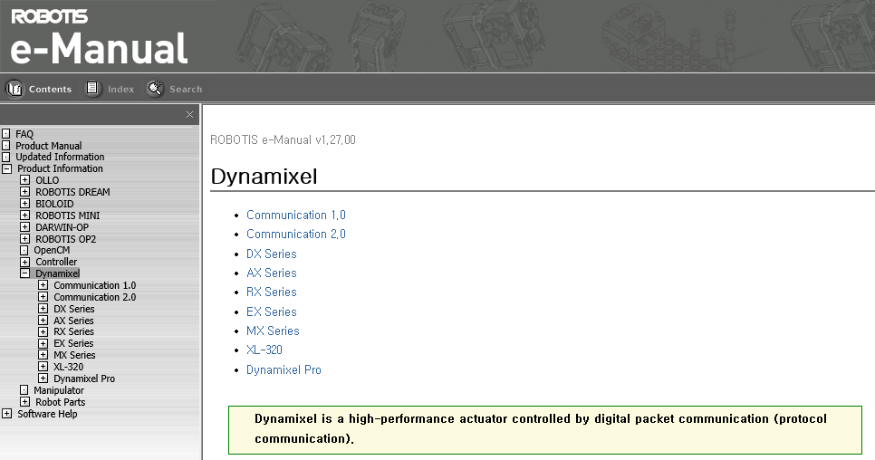
Information
For the details, please visit ROBOTIS support page
: support.robotis.com/en/

